Slide 1
CREDIT CARD CUSTOMER SEGMENTATION
TEAM LEAD: MR. ANUJ SAINI
SCRUM MASTER: ADITYA SHAH
TEAM MEMBERS: JAY SHAH
JINI BHANUSHALI
MITALI PATIL
RADHA SAWANT

Slide 2
OUTLINE
Introduction
Problem Statement
Objectives
Project Architecture
Preparation of Data
Exploratory Data Analysis
Column wise analysis of data
Feature Engineering Selection/Creation
K-Means
What we are doing
Model 1
Model 2
Conclusion

Slide 3

JOURNEY
CONCEPTS EDA Feature Engineering Machine Learning Unsupervised Learning K Means DBSCAN Autoencoder Hierarchical | TOOLS GitHub MS Lists tracker Microsoft Teams Jupyter Notebook Word Documentation Google slides Excel Heroku

Slide 4
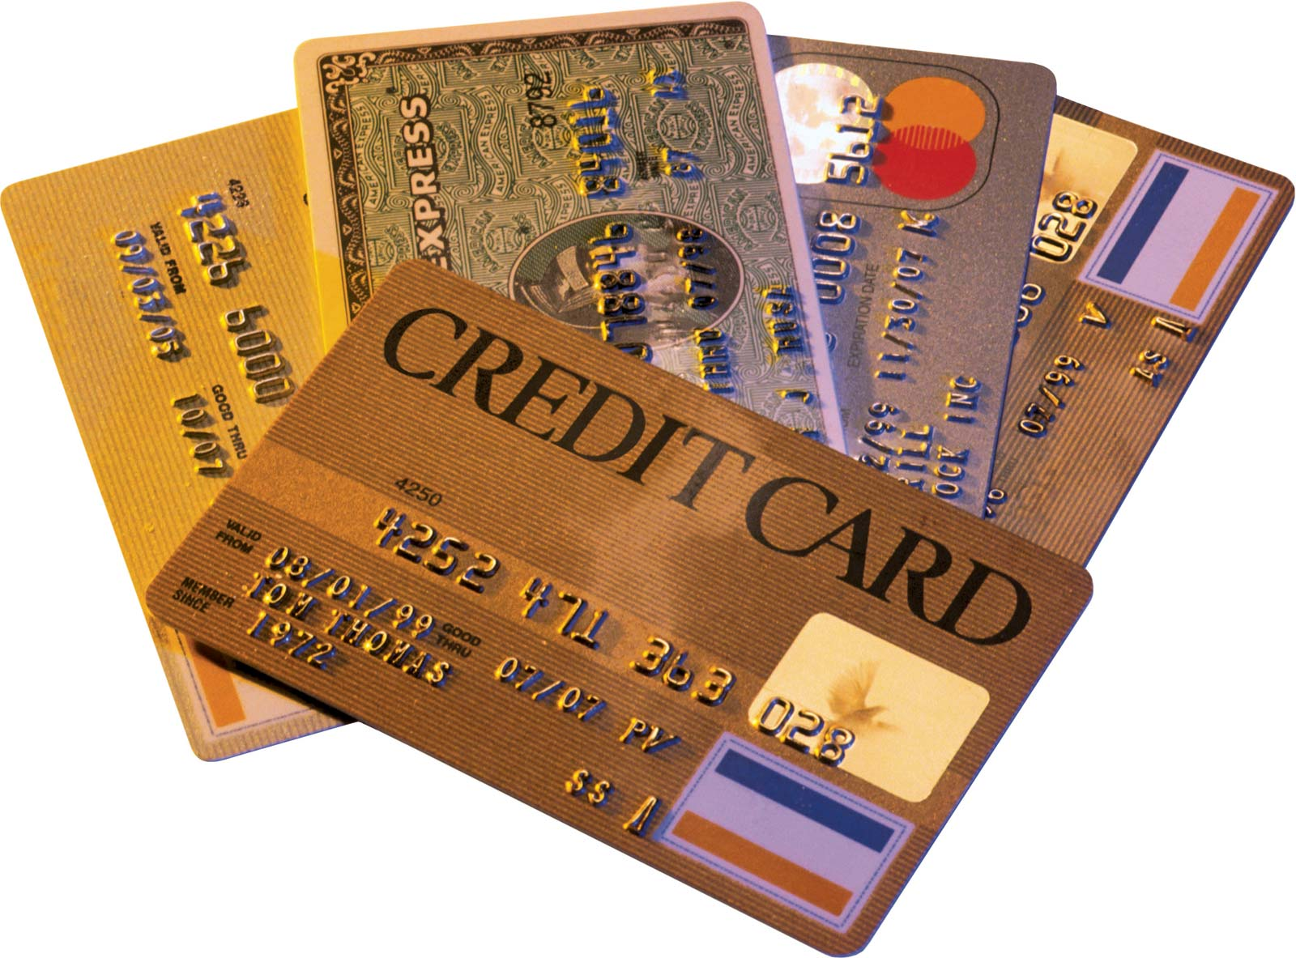
INTRODUCTION
Credit cards are a very important source of revenues for banks all over the world! Issuers find it difficult to differentiate between their customers based on their behaviours, payment and spending patterns.
What is customer segmentation?
Customer segmentation is the division of customers into groups depending upon their similar activities to one another.

Slide 5
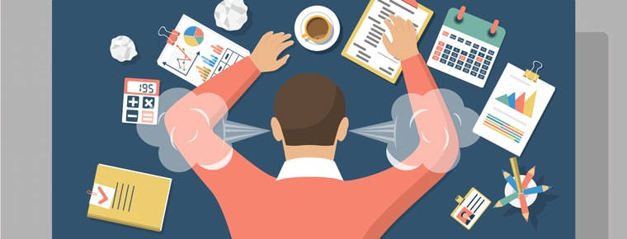
PROBLEM STATEMENT
RBL’s marketing department collects various customer specific data of the credit card holders. They need a mechanism to segment the customer based to target and provide product ideas to the management. Currently these tasks are performed manually, which is leading to human errors, biased decisions, and other such factors. So, the management wants to design a system that would automate this process and help the different stakeholders to make informed business decision.

Slide 6

OBJECTIVES
Develop a solution
Implement various clustering algorithm
Identify the best model
Deploy the machine learning model
Design a UI

Slide 7
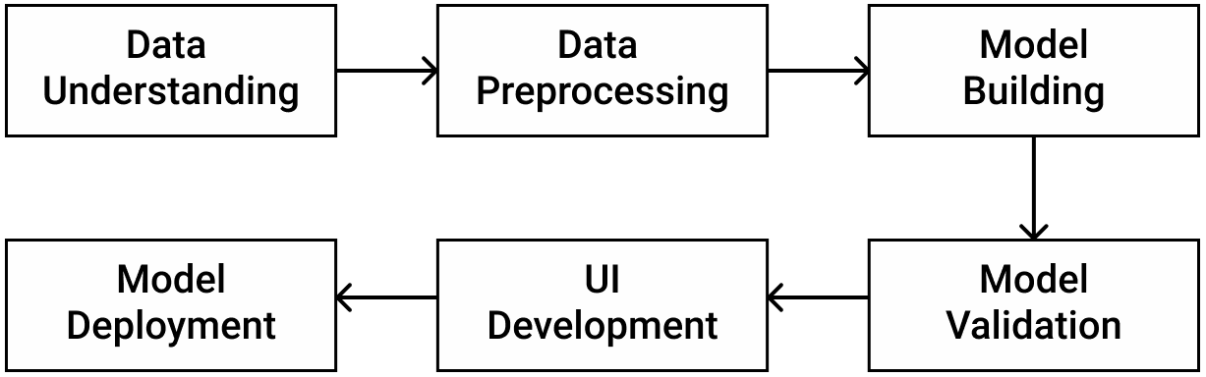
PROJECT ARCHITECTURE

Slide 8
PREPARATION OF DATA
Loading the dataset
Performed initial analysis of the dataset
Reduced the business sense of the columns
Column CREDIT LIMIT with only one row having null value was dropped from the dataset
Column MINIMUM PAYMENTS had around 313 missing rows.
Column CUST ID was dropped

Slide 9
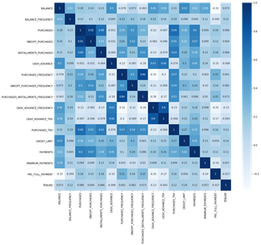
EXPLORATORY DATA ANALYSIS
PURACHASES_INSTALLMENTS_FREQUECY
has strong positive correlation with PURCHASE FREQUENCY
BALANCE has a strong negative correlation with PRC_FULL_PAYMENT
TENURE has almost no correlation with any (No linear relationship)
Purchases has a positive correlation with One-Off purchase of 0.92.
PURCHASES FREQUENCY has a positive correlation with PURCHASES INSTALLMENT FREQUENCY of 0.86.
CASH ADVANCE_TRX has a positive correlation with CASH ADVANCE_FREQUENCY of 0.8.
HEAT MAP

Slide 10
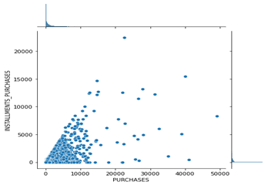
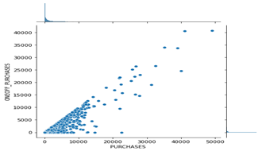
COLUMN-WISE ANALYSIS OF DATA
Purchases vs Installment Purchases
Purchases vs One-off Purchases
There is a linear correlation between both the graphs which means that one off purchase is a result of subtraction of Installment Purchases, from Purchases, so we can discard one of these columns.

Slide 11
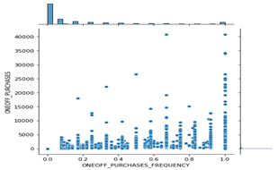
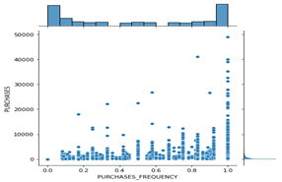
One-off Purchases vs One-off Purchase Frequency
Purchases vs Purchases Frequency
We can discard one of the columns from One-off Purchases and its Frequency as it shows increasing frequency with the increase in purchase, and the same for Purchase and its Frequency.

Slide 12
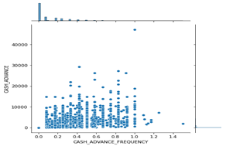
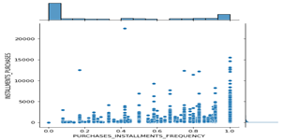
Cash Advance vs
Cash Advance Frequency
Installment Purchases VS
Installment Purchase Frequency
Cash advance and its frequency shows no trend, so both can be used. However, one column from Installments Purchases and its Frequency can be discarded as they show a similar trend.

Slide 13
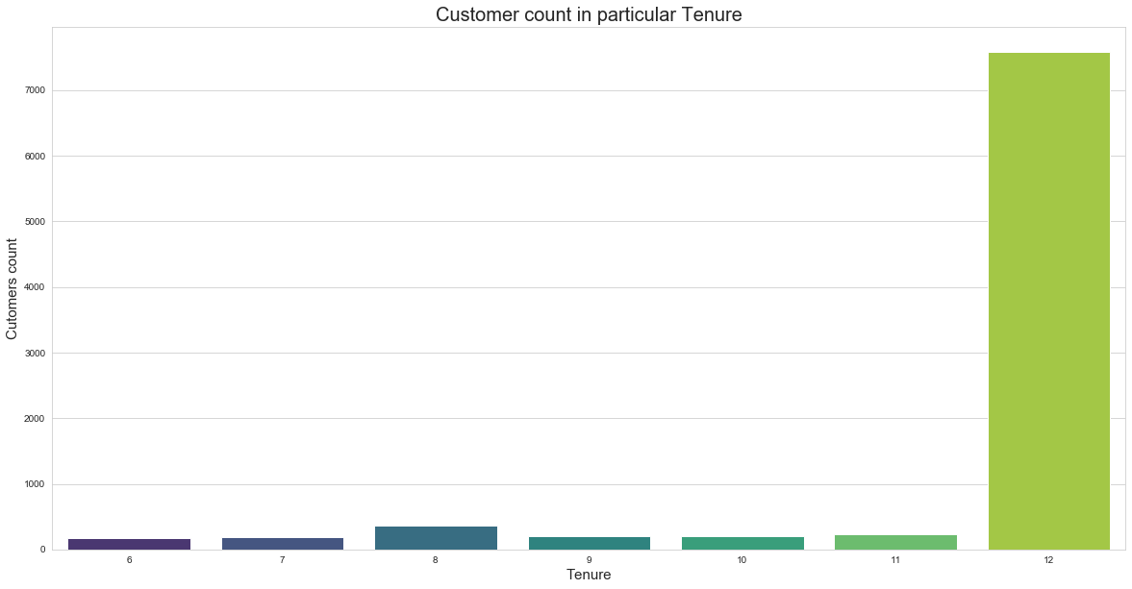
TENURE
Most of the customers have 12 year as their Tenure, so we will have to further analyze this data and hence keep the tenure column in the final dataset.

Slide 14
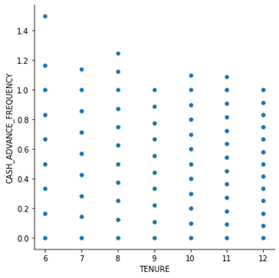
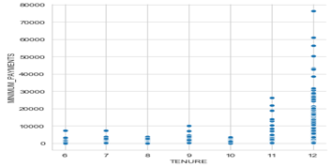
Tenure vs Cash Advance Frequency
Old customer with 12 years has cash frequency less than one the new customer who takes more cash advance.
Tenure vs Minimum Payments
More the tenure more minimum payment.

Slide 15
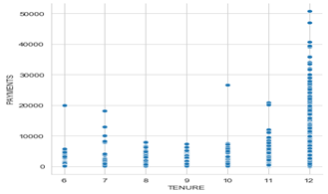
Tenure vs Payments
More payments mean customer is old customer because they are more familiar with the payment system.
Insights: Customers with a tenure range of 12 years have Higher spending power, they also pay the credit amount, and take the least cash advance.

Slide 16
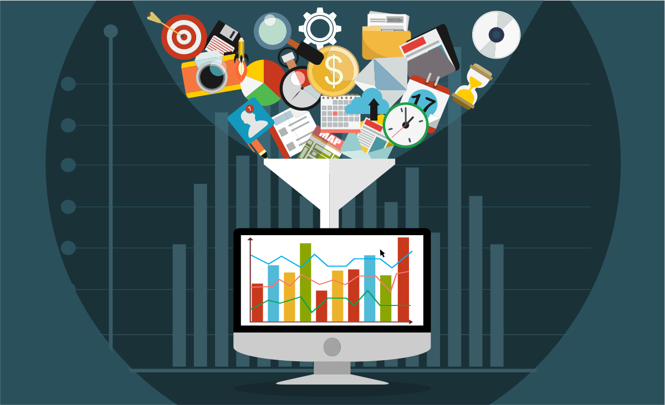
FEATURE ENGINEERING SELECTION / CREATION
The feature engineering and the new features that were created are:
TOT TRX column was created by adding the PURCHASES AND CASH ADVANCE.
Average Cash Advance column was created by dividing cash advance by its tenure.
Average Purchases column was created by adding dividing purchases by its tenure.

Slide 17
K-MEANS ALGORITHM
Group data into K-clusters by:
Determining the k centroid
Group the data points to the nearest centroid
Algorithm works by iterating between two stages until the data points converge
Objective :
High Level Description

Slide 18
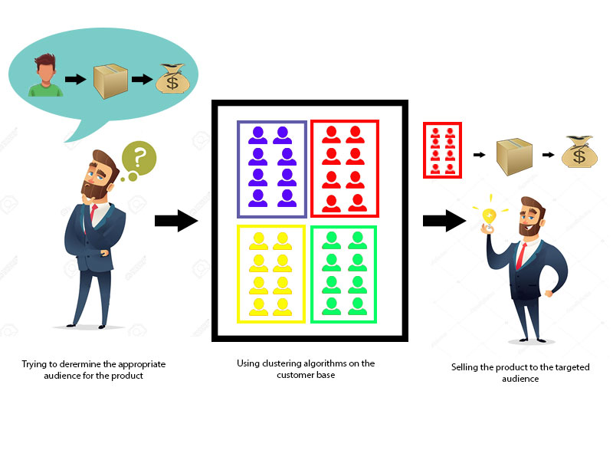
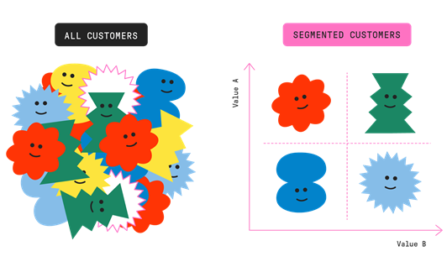
WHAT ARE WE DOING

Slide 19
MODEL 1

Slide 20
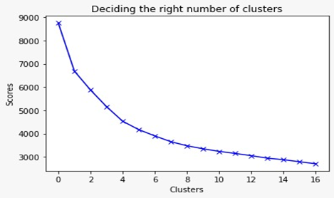
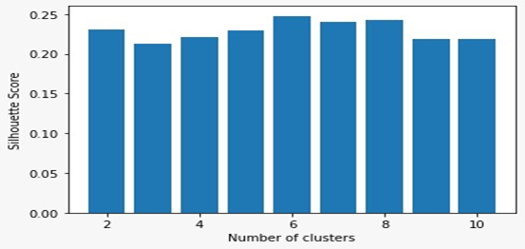
NUMBER OF CLUSTERS
ELBOW METHOD
SILHOUETTE

Slide 21
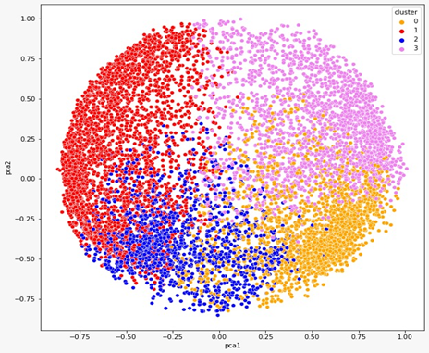
CLUSTERS
Cluster 0 (Gold)
Cluster 1 (Silver)
Cluster 2 (Bronze)
Cluster 3 (Platinum)

Slide 22
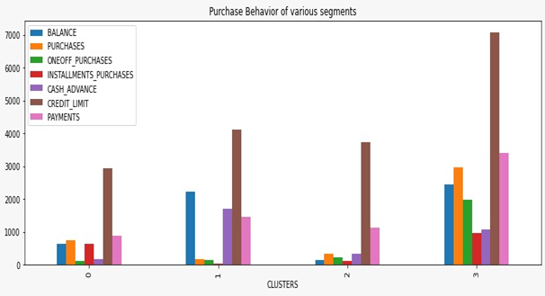

Slide 23
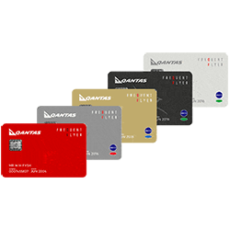
BUSINESS INSIGHTS
Cluster 0 (Gold): These type of customers have a pretty good credit limit and balance but they mainly spend cash advance rather than purchasing. These customers should be given schemes accordingly to increase their purchase.
Cluster 1 (Silver): Credit limit of customers of cluster 1 is lowest amongst all. These customers have a low balance but quite high purchases and installment purchases. These customers have a very low one-off purchase and cash advance.

Slide 24
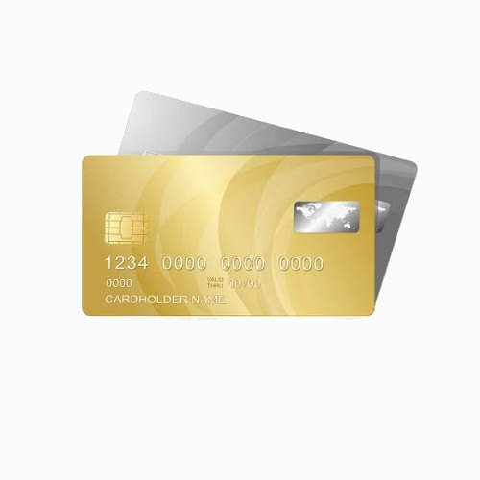
BUSINESS INSIGHTS
Cluster 2 (Bronze): These customers have a good credit limit but their balance, purchases is very low. So, these customers should be encouraged by giving schemes to spend more.
Cluster 3 (Platinum): These customers have the highest credit limit and purchases. They have highest payment of all clusters. These customers should be encouraged to keep decent balance in their account by keeping a minimum balance rule.e

Slide 25
MODEL 2

Slide 26
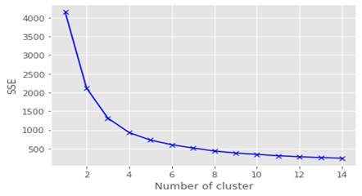
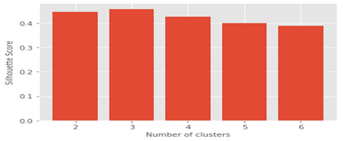
NUMBER OF CLUSTERS
ELBOW METHOD
SILHOUETTE

Slide 27
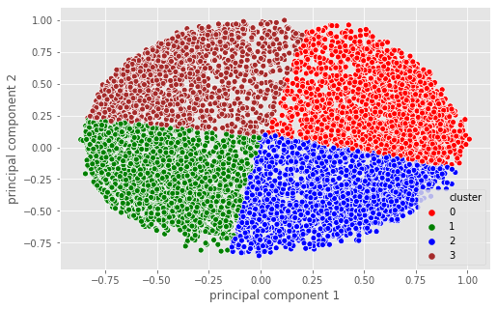
CLUSTERS
GROUP 0 - Middle class but good buyers
Group 1 - Rich but purchase less
Group 2 - Cream customers
Group 3 - Poor and inert

Slide 28
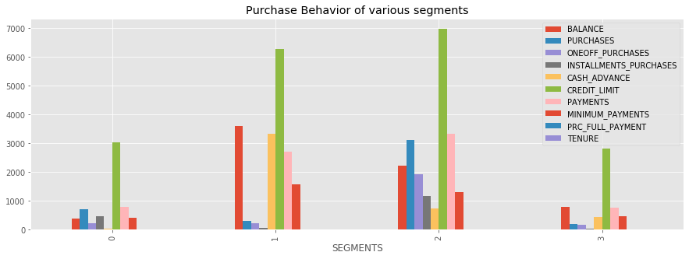

Slide 29

BUSINESS INSIGHTS AND RECOMMENDATION
GROUP 0 - Good Buyers with mediocre finances BUSINESS INSIGHTS:
Balance is less
Purchase without taking much cash advance
Prefer installments for purchases
Customers with good purchase even though balance is less
BUSINESS RECOMMENDATION :
Give them schemes of discounts on some expensive products so that they are attracted to buy more stuff since they are frequent buyers
Good number of people in this group so the company should definitely focus more on them
Make sure to repay the installments on time

Slide 30

BUSINESS INSIGHTS AND RECOMMENDATION
Group 1 - Good finances But Purchase less
BUSINESS INSIGHTS:
Rich people with a lot of balance
Not frequent buyers
Take a lot of cash advance to purchase suggesting that they buy expensive items
New customers and are few in quantity
BUSINESS RECOMMENDATION:
We need to provide them schemes for buying expensive and ordinary items
If through the schemes they can spend money on that as well then they have the capacity to bring a lot of profit

Slide 31
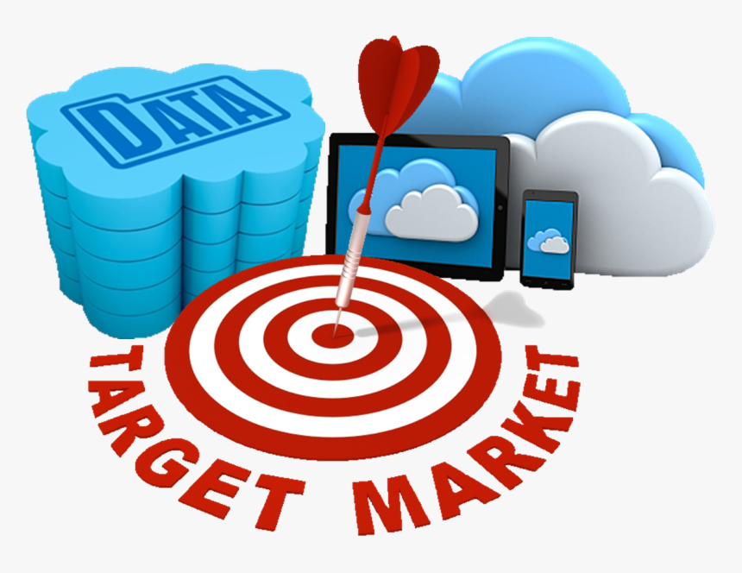
BUSINESS INSIGHTS AND RECOMMENDATION
Group 2 - Elite Customers
BUSINESS INSIGHTS:
The elite customers who have been there for a long time now and even do a lot of purchases
Take minimal cash advance and installments to do purchases
They even have a good balance
BUSINESS RECOMMENDATION:
Make sure not to lose them.
Come up with schemes which benefits them the most.

Slide 32

BUSINESS INSIGHTS AND RECOMMENDATION
Group 3 - Low Finances and Inert
BUSINESS INSIGHTS:
Less balance and not much purchases.
Don't take cash advance and installments
Good amount of such customers who have also been there for a good time.
BUSINESS RECOMMENDATION:
Focus a lot on them as they are a lot in number and aren't giving much profits.
Come up with the schemes that make them active users

Slide 33
TECHNOLOGY STACK
NumPy - working with arrays
Pandas - flexible and expressive data structures
Matplotlib - for basic plotting using bars, pies, lines, scatter plots and so on
Seaborn - provides variety of visualization patterns to show the distribution in the data
Plotly - interactive and publication-quality graphs
Sklearn - machine learning library that supports supervised and unsupervised learning
Flask - micro web framework written in Python
HTML & CSS - for UI

Slide 34
UI

Slide 35
UI DEVELOPMENT
In order to develop an interactive and smooth User Interface (UI) to enable the end user for input his/her own inputs and receive model insights, we have used web development frameworks such as HTML, CSS.
We incorporated three model along with user inputs and predict buttons for each of these models that are integrated with the backend using Flask Framework.
Flask is a micro web framework written in python. It is classified as micro framework because it doesn’t require any particular tools and libraries.

Slide 36
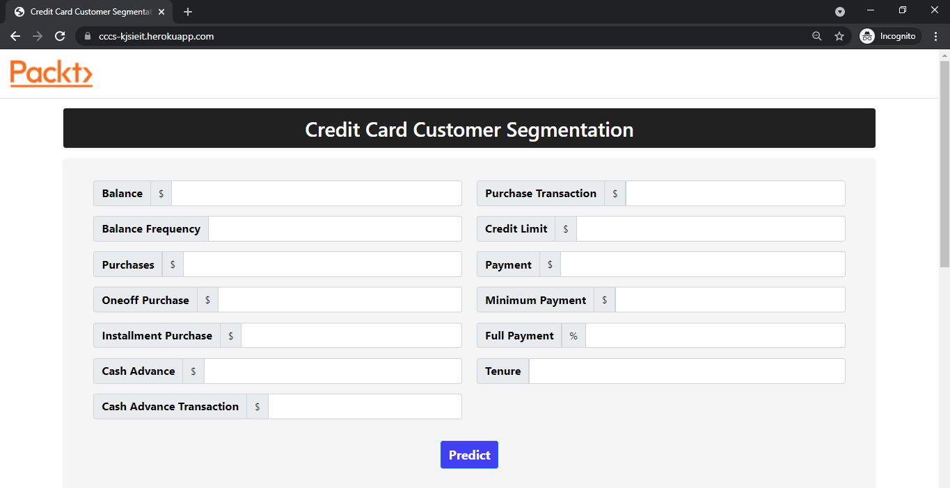

Slide 37
DEPLOYMENT & UI TESTING
Flask API was used to deploy the machine learning model in backend. It is used to manage HTTP requests and uses API function to get the data and display the result to the end user in front end UI.
User enters the inputs in the form, post routing of those values, our machine learning model makes predictions and returns the same.
As a final result, on inputting the user inputs, a backend call routed via Flask framework helps us in providing relevant insights and recommendations to the end user.

Slide 38
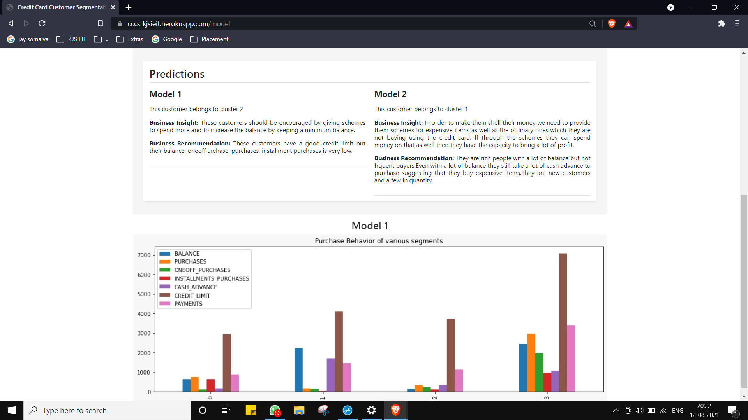

Slide 39
CONCLUSION
We learnt operations on data.
Initial Data Quality measures were performed for making the data useful for further analysis.
Performing EDA to obtain information on how the data was impacting certain business requirements.
Feature correlations were visualized and their distributions were plotted.
Learnt data quality improvement measures post EDA.
Multiple trials of various cluster formation techniques were implemented to finalize best possible algorithm to implement.
Cluster visualization helped us determine the critical features and their insights to conclude on business recommendations.
UI development was done in order to create UI for determining the clusters based on inputs.

Slide 40
FUTURE SCOPE
More user interaction and automatic UI features
Implementing different clustering algorithms
Interactive graphs

Slide 41
THANK YOU!

Slide 42
ANY QUESTIONS?

Slide 43
Clustering Algorithms in Unsupervised Machine Learning

Slide 44
DBSCAN
DBSCAN (Density-Based Spatial Clustering of Applications with Noise) is a popular learning method utilized in model building and machine learning algorithms. This is a clustering method that is used in machine learning to separate clusters of high density from clusters of low density. Clustering analysis or simply Clustering is basically an unsupervised learning method that divides the data points into a number of specific batches or groups, such that the data points in the same groups have similar properties and data points in different groups have different properties in some sense.

Slide 45
Auto Encoder
Autoencoders are a type of artificial neural network that is used to learn feature representation in an unsupervised manner. It uses the same data for input and output. By adding a bottleneck in the network, it forces the network to create a compressed version of the input data, which is how the encoder works. Meanwhile, the decoder reconstructs the encoded features to its original input.
There are different types of autoencoder models. In a stacked autoencoder model, encoder and decoder have multiple hidden layers for encoding and decoding.
Clustering is difficult to do in high dimensions because the distance between most pairs of points is similar. Using an autoencoder lets you re-represent high dimensional points in a lower-dimensional space. It doesn't do clustering per se - but it is a useful preprocessing step for a secondary clustering step. You would map each input vector xixi to a vector zizi (not a matrix...) with a smaller dimensionality, say 2 or 3. You'd then use some other clustering algorithm on all the zizi values

Slide 46
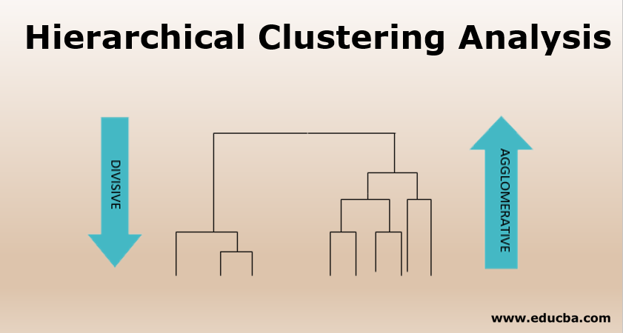
HIERARCHICAL CLUSTERING
Hierarchical clustering, also known as hierarchical cluster analysis, is an algorithm that groups similar objects into groups called clusters. The endpoint is a set of clusters, where each cluster is distinct from each other cluster, and the objects within each cluster are broadly similar to each other.
Hierarchical clustering can be performed with either a distance matrix or raw data. When raw data is provided, the software will automatically compute a distance matrix in the background.

